Slide 1
Session 8
Correlation
And
Scatterplots

Slide 2
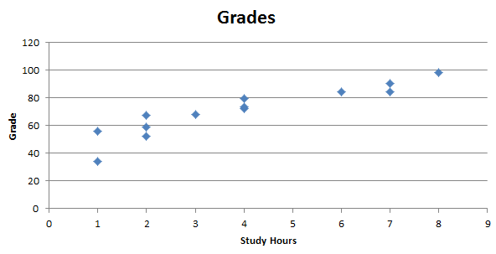
Key Concept: Sample linear correlation coefficient r
Study Hours by Grades
We would like a numerical measurement of the strength of the relationship between two variables representing quantitative data.

Slide 3
Exploring the Data
We can often see a relationship between two variables by constructing a SCATTERPLOT.
Notes:
Relate a scatter plot to the algebraic plotting of number pairs (x,y).

Slide 4
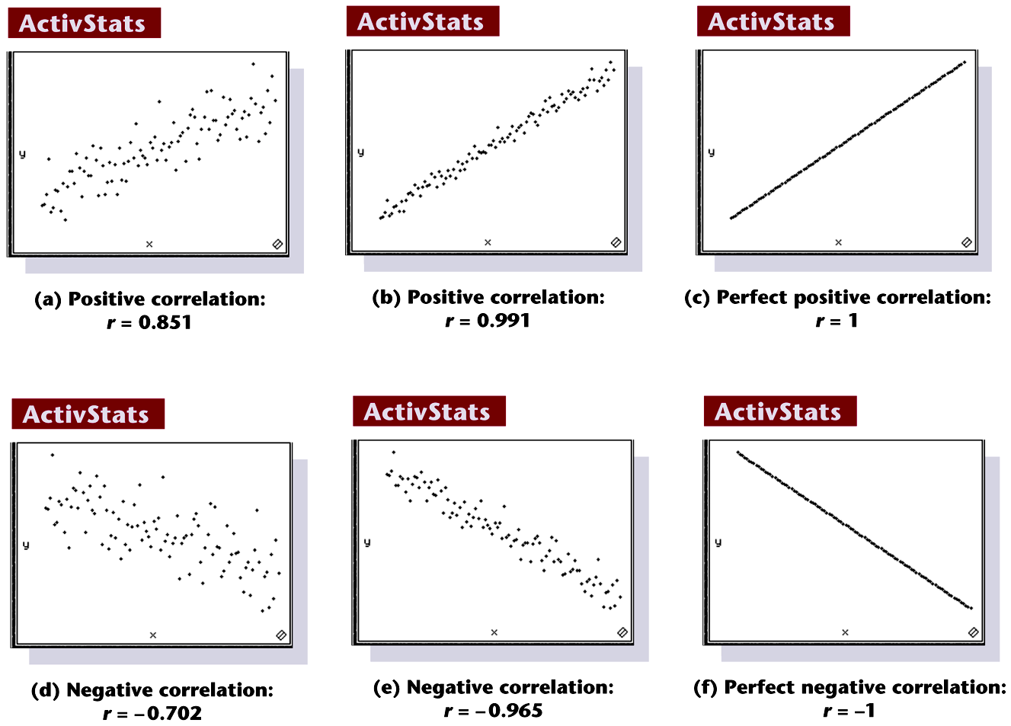
Scatterpplots of Paired Data: We can often see a relationship between two variables by constructing a SCATTERPLOT.
Notes:
Page 619 of text

Slide 5
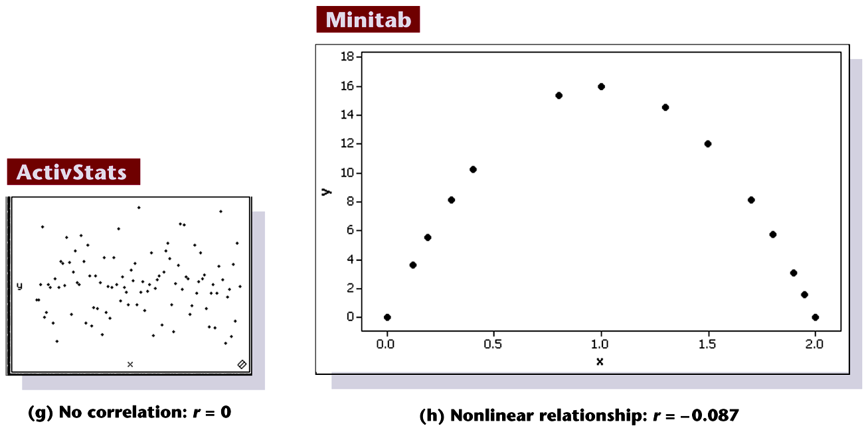
Scatterpplots of Paired Data - Continued
Notes:
Page 619 of text

Slide 6
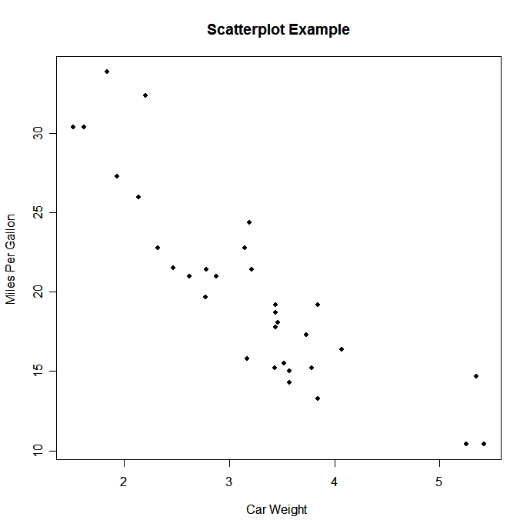

Which correlation coefficient best describes the scatter plot?
r = .32
r = 0
r = -1
r = -.78
r = -.1
r = .80

Slide 7
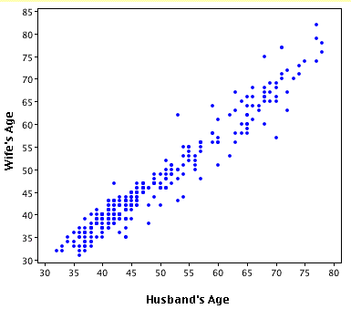
Which correlation coefficient best describes the scatter plot?
r = .32
r = -.89
r = 1
r = -.345
r = .95
r = -.5

Slide 8
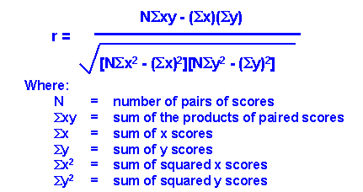
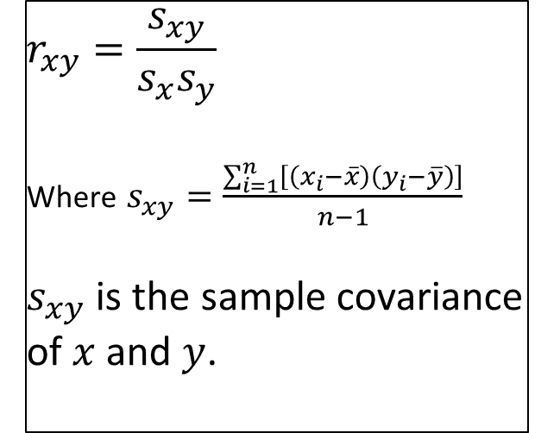
How do we find r? Formulas Below!
$$r_{xy}=\frac{s_{xy}}{s_{x}s_{y}}$$
Where $s_{xy}=\frac{\sum_{i=1}^{n}{\left[\left(x_{i}−\overline{x}\right)\left(y_{i}−\overline{y}\right)\right]}}{n−1}$
$s_{xy}$ is the sample covariance of $x$ and $y$.
=>

Slide 9
Properties of the Sample Linear Correlation Coefficient r
1. r measures strength of a linear relationship.
2. –1 ≤ r ≤ 1
3. The value of r does not change if the x and y variables (axes) are switched. (Try it with an example and with the formula!)
4. The value of r does not change if all values of either variable are converted linearly (new_x = a*old_x +b) to a different scale, i.e., not a nonlinear transformation like a log transformation. (Try it!)
Notes:
page 524 of text
If using a graphics calculator for demonstration, it will be an easy exercise to switch the x and y values to show that the value of r will not change.

Slide 10
Requirements to Get Interpretable Correlation Coefficient
The paired (x, y) data is independent, quantitative data.
Visual examination of the scatterplot must confirm that the points approximate a straight-line pattern.
The outliers must be removed if they are known to be errors. The effects of any other outliers should be considered by calculating r with and without the outliers included.
The standard deviation of one variable should be equal across values of the other variable.
To generalize the results to a broader population, the sample should be randomly selected from the population.
In general, correlation does not imply causation. To imply causation, the subjects must be randomly assigned to different values of the independent variable. (Note that the values of the independent variable do not need to be random. For example, they could be equally spaced levels of a factor.)
Notes:
page 520 of text
Explain to students the difference between the ‘paired’ data of this chapter and the investigation of two groups of data in Chapter 9.

Slide 11
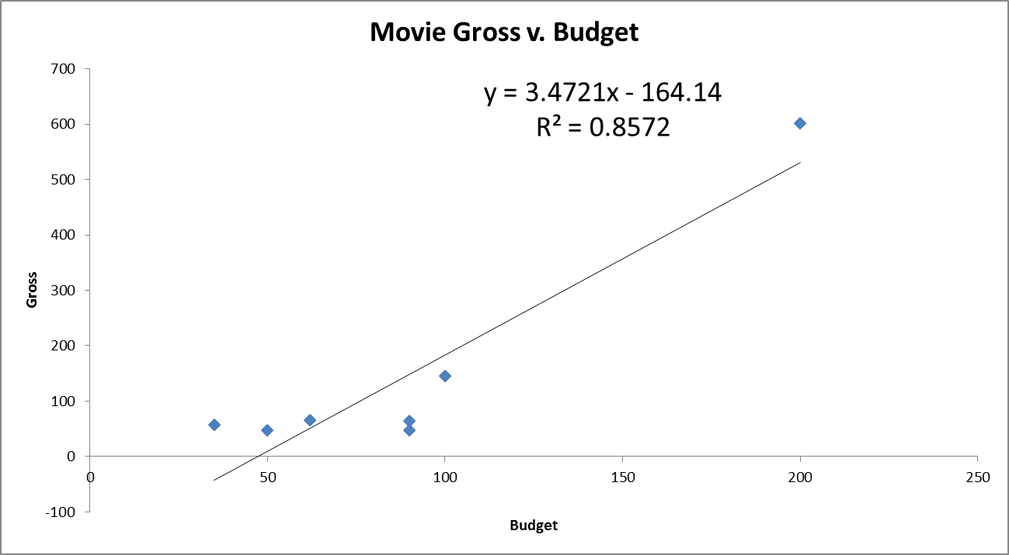
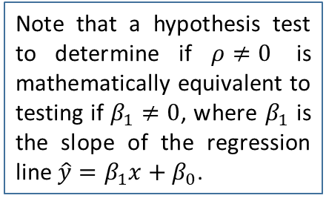
Correlation: Not resistant to outliers
$ρ$ is the population correlation that $r$ estimates with the sample data
Note that a hypothesis test to determine if $ρ≠0$ is mathematically equivalent to testing if $β_{1}≠0$, where $β_{1}$ is the slope of the regression line $\hat{y}=β_{1}x+β_{0}$.
TS is test statistic for R
(see slides below)
Outlier Removed

Slide 12
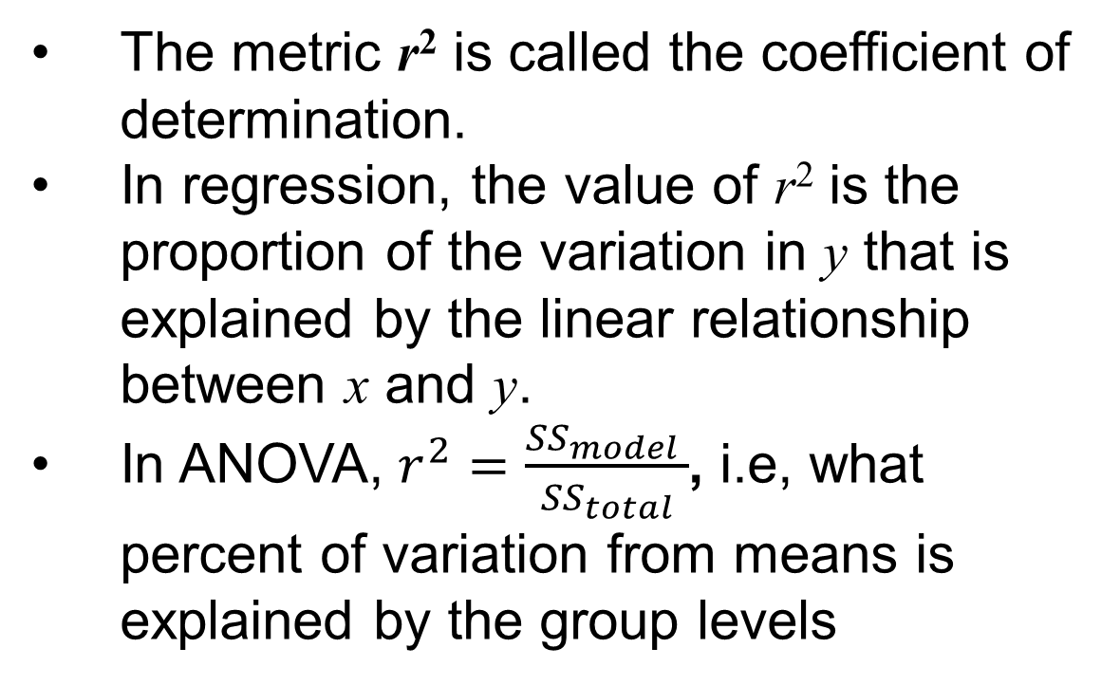
Interpreting r²: Explained Variation
The metric r² is called the coefficient of determination.
In regression, the value of r² is the proportion of the variation in y that is explained by the linear relationship between x and y.
In ANOVA, $r^{2}=\frac{{SS}_{model} }{{SS}_{total}}$, i.e, what percent of variation from means is explained by the group levels
Notes:
page 524 of text
If using a graphics calculator for demonstration, it will be an easy exercise to switch the x and y values to show that the value of r will not change.

Slide 13
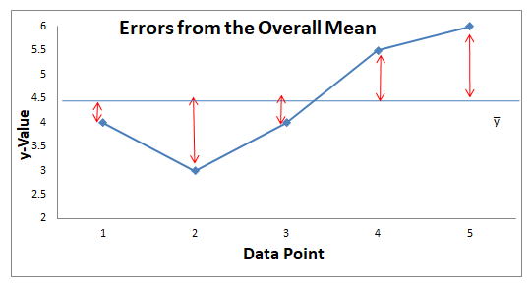
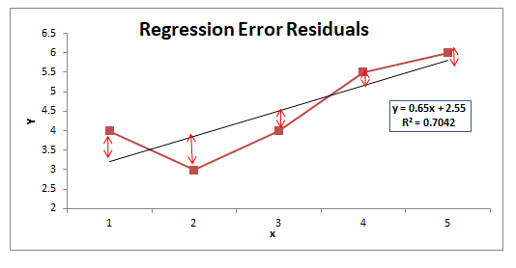
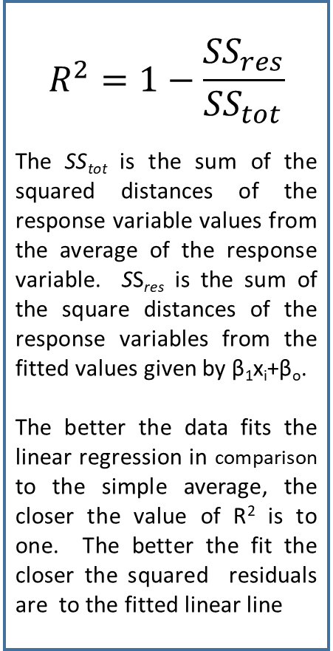
R²: Compares SS(straight line regression model) to SS(equal means Model)
$$R^{2}=1−\frac{{SS}_{res}}{{SS}_{tot}}$$
The SS_{tot} is the sum of the squared distances of the response variable values from the average of the response variable. SS_{res} is the sum of the square distances of the response variables from the fitted values given by β₁x_{i}+β_{o}.
The better the data fits the linear regression in comparison to the simple average, the closer the value of R² is to one. The better the fit the closer the squared residuals are to the fitted linear line

Slide 14
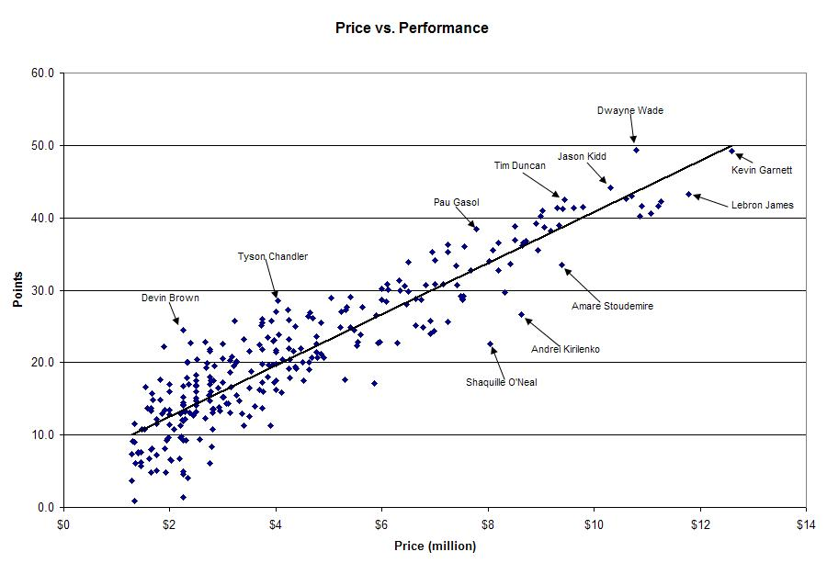
Another example of regression of basketball players salary
on a measure of point production
r = 0.907
r² = 0. 823
Red brackets imply equal variances at each price point.
Price explains 82.3% of the variation in point production for NBA players.

Slide 15
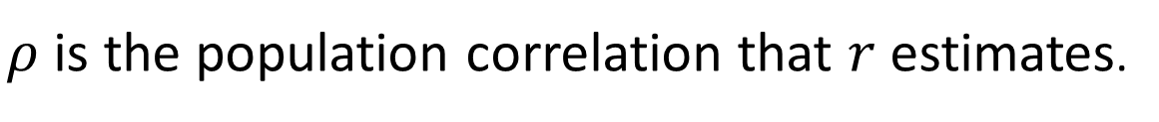
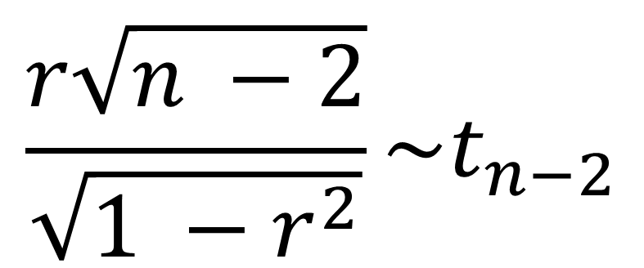
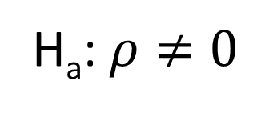
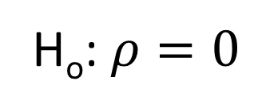
The Test Statistic for R²
$ρ$ is the population correlation that $r$ estimates.
H_{o}: $ρ=0$
H_{a}: $ρ≠0$
$$\frac{r\sqrt{n −2}}{\sqrt{1 −r^{2}}}\sim t_{n−2}$$

Slide 16
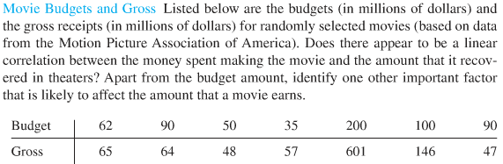
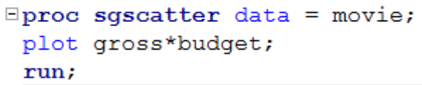
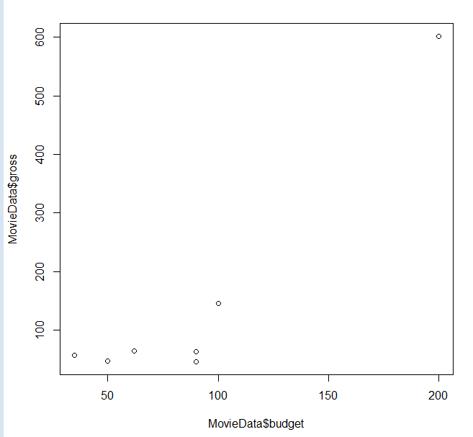
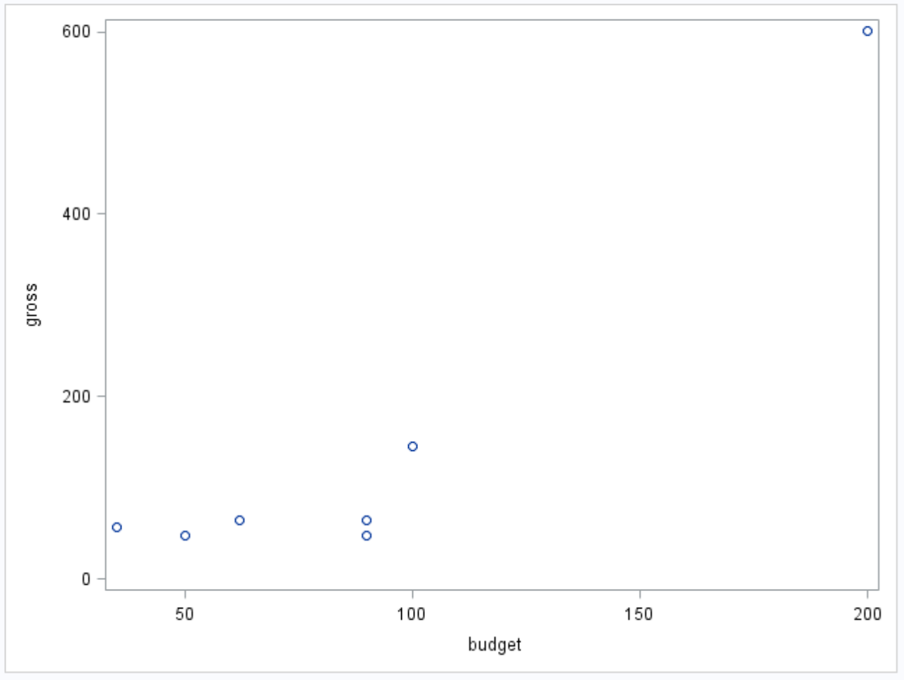
Example: Movie Budget and Gross
R and SAS: Check the scatter plot to determine if a linear relationship is plausible.
R Plot
R Plot
SAS Plot

Slide 17
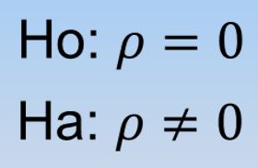
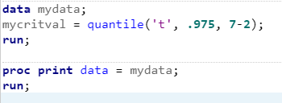

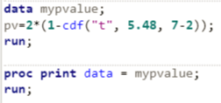


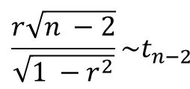


Example: Movie Budget and Gross - continued
$$\frac{r\sqrt{n −2}}{\sqrt{1 −r^{2}}}\sim t_{n−2}$$
It is estimated that r² = 85.7% of the variation in the Gross Sales is explained by the Movie Budget!
Critical Value (use software)
$$±t_{.975, 7−2}=±2.57$$
Because the data is randomly selected, the results can be generalized to the entire population of movies associated with the MPAA. Because the budgets were not randomly assigned, causality cannot be established, only association.
Test statistic
$$t=\frac{.926\sqrt{7 −2}}{\sqrt{1 −{.926}^{2}}}$$
$$=\frac{.926\sqrt{5}}{\sqrt{1−.857}} =5.48$$
There is sufficient evidence at the alpha = .05 level of significance to suggest that the data are linearly correlated (p-value = .0028). We will skip the confidence interval for $ρ$ for now. Note, other factors that affect gross sales may include the type of movie, the actors in the movie, etc.
P-value for t =.0028
Reject H_{o}

Slide 18
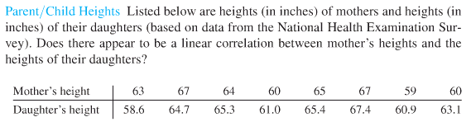
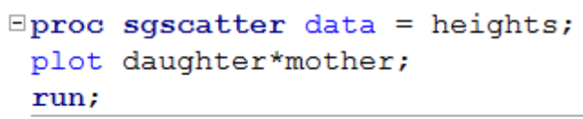
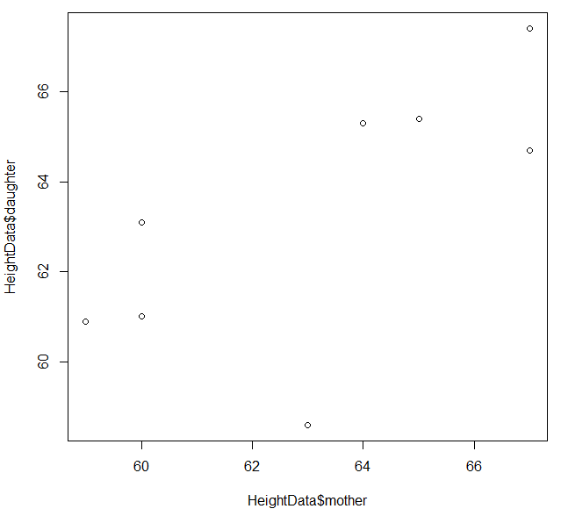
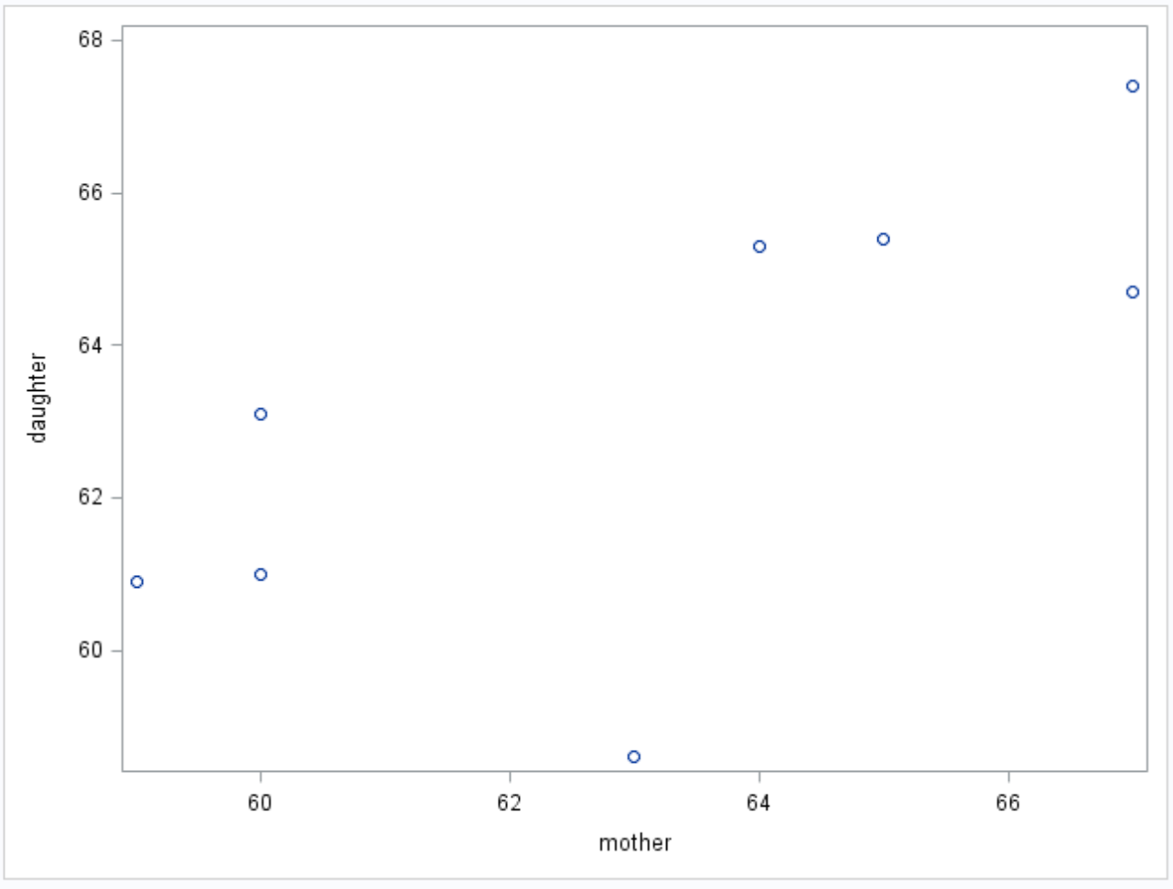
Example: Mother/Daughter Heights
R and SAS: Check the scatter plot to determine if a linear relationship is plausible.
R Plot
SAS Plot
SAS Plot

Slide 19


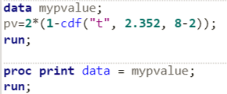
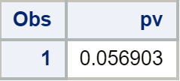


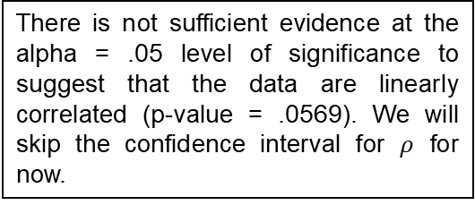
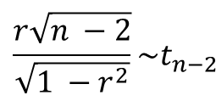
Example: Mother/Daughter Heights
$$\frac{r\sqrt{n −2}}{\sqrt{1 −r^{2}}}\sim t_{n−2}$$
It is estimated that r² = 48% of the variation in the Daughter height is explained by the Mother height!
Critical Value (use software)
$$±t_{.975, 8−2}=±2.45$$
Test statistic
There is not sufficient evidence at the alpha = .05 level of significance to suggest that the data are linearly correlated (p-value = .0569). We will skip the confidence interval for $ρ$ for now.
$$t=\frac{.693\sqrt{8−2}}{\sqrt{1 −{.693}^{2}}}$$
$$=\frac{.693\sqrt{6}}{\sqrt{1−.48}}$$
$$=2.352$$
Because the we do not know much about how the data was sampled, the results cannot be generalized to the entire population of mothers and daughter in the NHES. Because the results are not significant, there is no need to discuss causality.
P-value =.0569
Fail to Reject Ho
(at alpha = 0.05)

Slide 20
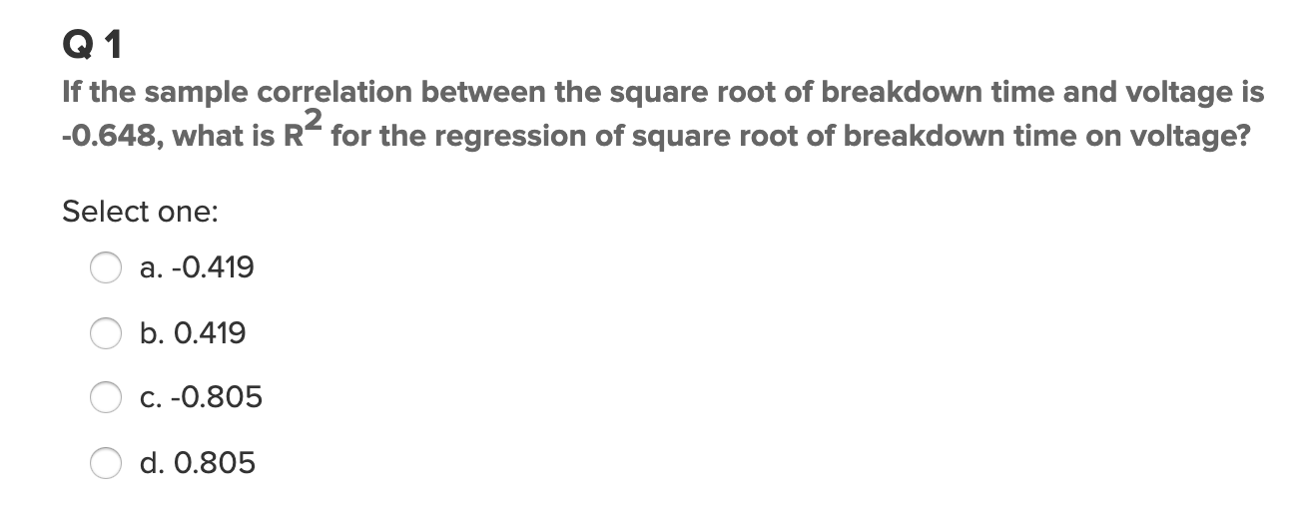
Quick Quiz Questions: Q1

Slide 21
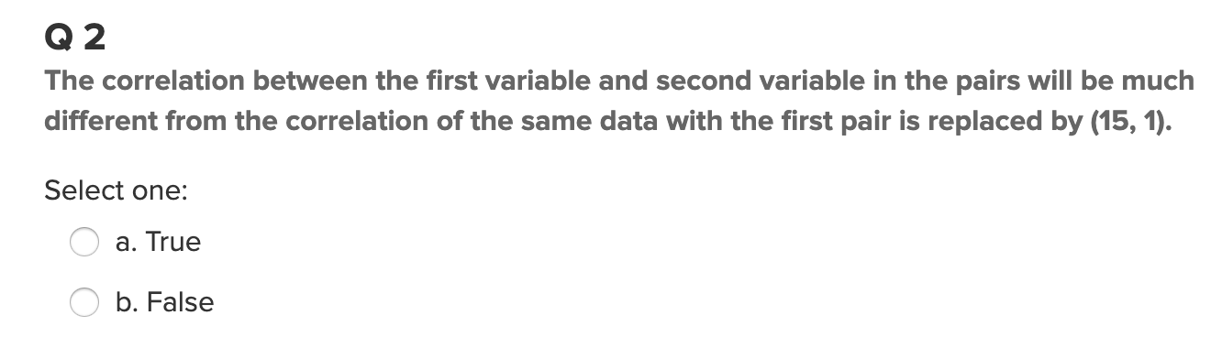
Quick Quiz Questions: Q2
What is wrong with this question?

Slide 22
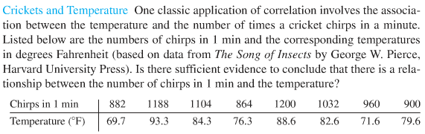

Exercise 1: Crickets
Use SAS OR R to find r and then manually conduct a formal 6 step hypothesis test to test for linear correlation. You should also make note of whether a linear associations looks reasonable via visual inspection with software. Find and interpret r².
R - Code
SAS - Code

Slide 23
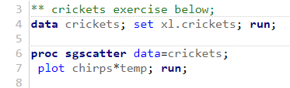
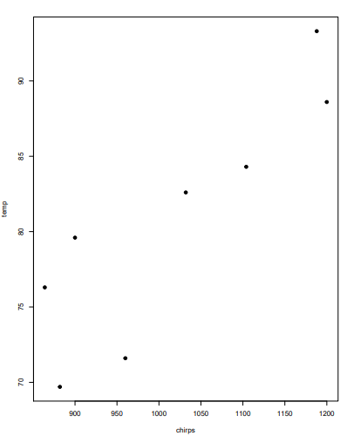
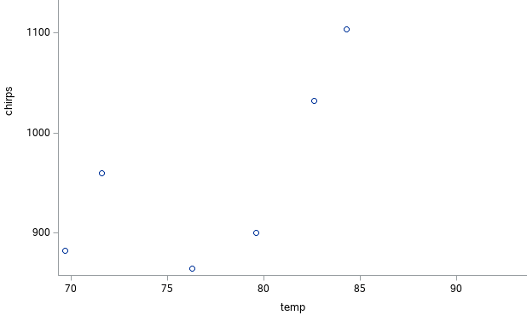
Exercise 1: Cricket Data R and SAS Scatter plot
SAS Code & Output
R Code & Output
plot(cricketsData,pch=19)

Slide 24

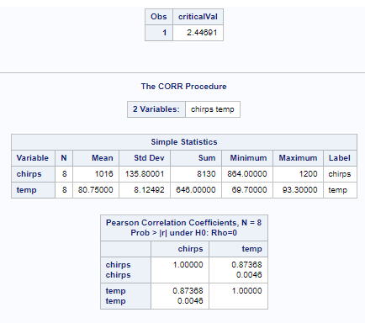
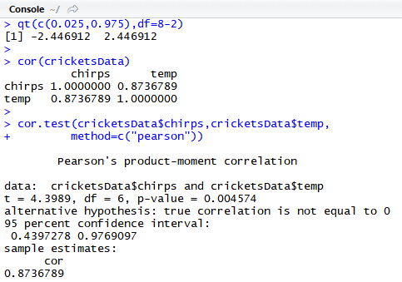

Exercise 1: Cricket Data SAS and R Critical values, correlations and p-values
$$\frac{r\sqrt{n −2}}{\sqrt{1 −r^{2}}}\sim t_{n−2}$$
R Code & Output
SAS Code & Output
qt(c(0.025,0.975),df=8-2)
cor(cricketsData)
cor.test(cricketsData$chirps,cricketsData$temp,
method=c("pearson"))

Slide 25
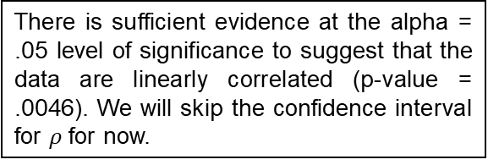


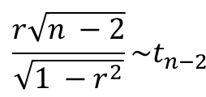
Exercise1 Crickets: Do t-test for correlation coefficient
$$\frac{r\sqrt{n −2}}{\sqrt{1 −r^{2}}}\sim t_{n−2}$$
It is estimated that r² = 87.4% of the variation in the Temperature is explained by the Chirps per Minute!
Critical Value
$$±t_{.975, 8−2}=±2.45$$
There is sufficient evidence at the alpha = .05 level of significance to suggest that the data are linearly correlated (p-value = .0046). We will skip the confidence interval for $ρ$ for now.
Test statistic
$$t=\frac{.874\sqrt{8 −2}}{\sqrt{1 −{.874}^{2}}}$$
$$=\frac{.874\sqrt{6}}{\sqrt{1−.764}}$$
$$=4.40$$
Because we do not know much about how the data was selected (at least within the scope of this PowerPoint), we cannot generalize the results beyond the data under study, though the results are interesting. Because the chirps per minute were not randomly assigned, causality cannot be established, only association.
P-value =.0046
Reject H_{o} (at level alpha = 0.05)

Slide 26
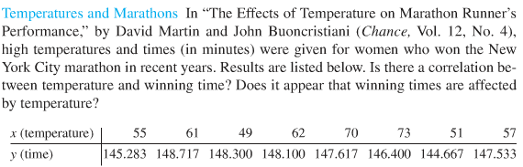
Exercise 2: Marathons
Use SAS OR R to find r and then manually conduct a formal 6 step hypothesis test to test for linear correlation. You should also make note of whether a linear associations looks reasonable via visual inspection with software. Find and interpret r².
See Previous Exercise for R and SAS Code

Slide 27



Exercise 2: Marathon Data R and SAS Scatter plot
SAS Code & Output
R Code & Output
plot(marathonData,pch=19)

Slide 28





Exercise 2: Marathon Data SAS and R Critical values, correlations and p-values
$$\frac{r\sqrt{n −2}}{\sqrt{1 −r^{2}}}\sim t_{n−2}$$
R Code & Output
SAS Code & Output

Slide 29




Exercise 2: Marathon: Do t-test for correlation coefficient
$$\frac{r\sqrt{n −2}}{\sqrt{1 −r^{2}}}\sim t_{n−2}$$
It is estimated that r² = 18.3% of the variation in the Temperature is explained by the Chirps per Minute!
Critical Value
$$±t_{.975, 8−2}=±2.45$$
There is not sufficient evidence at the alpha = .05 level of significance to suggest that the data are linearly correlated (p-value = 0.6642). We will skip the confidence interval for $ρ$ for now.
Test statistic
$$t=\frac{.183\sqrt{8 −2}}{\sqrt{1 −{.183}^{2}}}$$
$$=\frac{.183\sqrt{6}}{\sqrt{1−.033}}$$
$$=.4563$$
Because we do not know much about how the data was selected (at least within the scope of this PowerPoint), we cannot generalize the results beyond the data under study. Because no significant linear relationship is found, we cannot infer association between the variables, let alone causality.
P-value = 0.6642
Fail to Reject H_{o} (alpha = 0.05)

